Slide 1
ADS Project 4 Words 4 Music
Chenxi (Celia) Huang

Slide 2
Agenda
The Project
My Approach
My Findings
Concerns & Considerations

Slide 3
The Project
The Data
The million song data
"- /metadata, -/musicbrainz, -/analysis/songs" not provided in the test data.
The Goal
Based on the association patterns identified, we will create lyric words recommender algorithms for a piece of music (using its music features).
Evaluation Criteria (my translated version)
Error = mean(predicted ranks) – mean(actual ranks) of respective words

Slide 4
My Approach
Part I: Feature Engineering
Feature Creation
Feature Selection
Part II: Model Selection
Baseline
Clustering (K Means and Hierarchical Clustering)
Topic Modeling

Slide 5
Part I: Feature Engineering
Feature Creation
initially as many as possible
generate comprehensive statistics {Psych}
e.g. "vars, n, mean, sd, median, trimmed, mad, min, max, range, skew, kurtosis, se“
(16-1)*13 = 195 features in total for each song
Feature Selection
Data Cleaning (NA values, columns with mean=Inf or –Inf, etc)
PCA? (dimension reduction)
Random Forrest? (supervised learning)
Left with: 174 vs 153 features per song → 174 won

Slide 6
Model Selection
Baseline
Simple: based on all songs and their word rankings in lyr.data.
Clustering (why?)
Have used it before, comfortable with it
Good tutorial. Clear instructions
Essentially the same idea as Baseline.
Cluster j
C2
C3

Slide 7

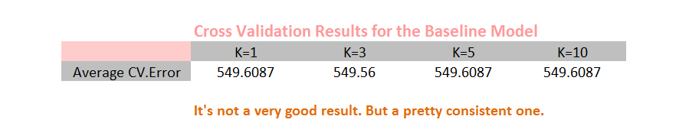
My Findings
Baseline Model

Slide 8
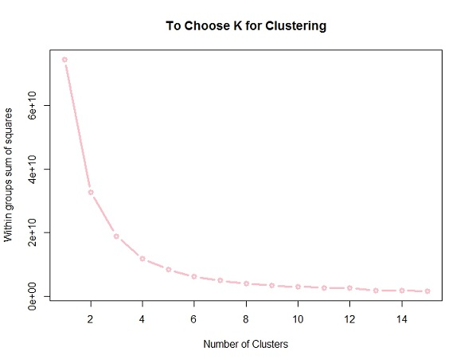
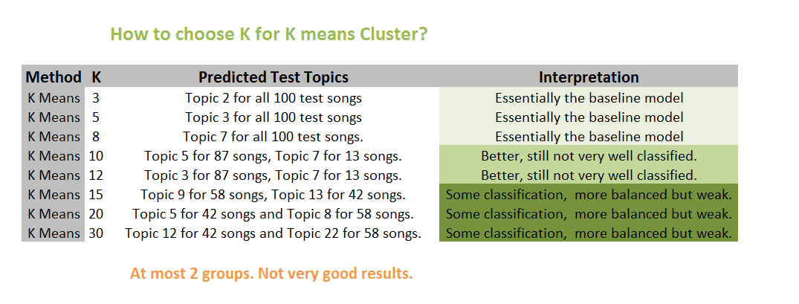
My Findings
K Means: How to choose K

Slide 9
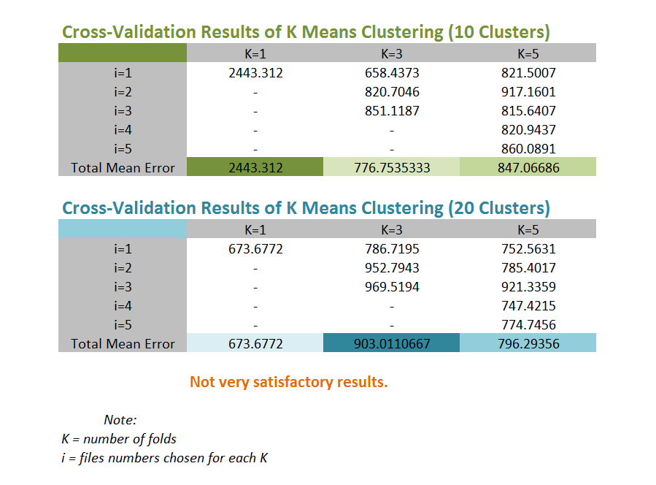
My findings
2. K Means: Cross Validation

Slide 10
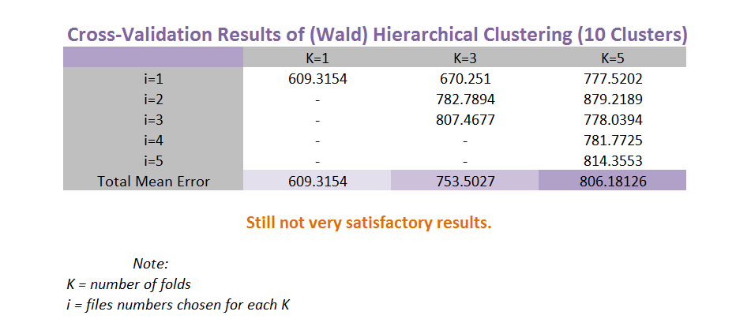
My findings
Hierarchical Clustering: Cross Validation

Slide 11
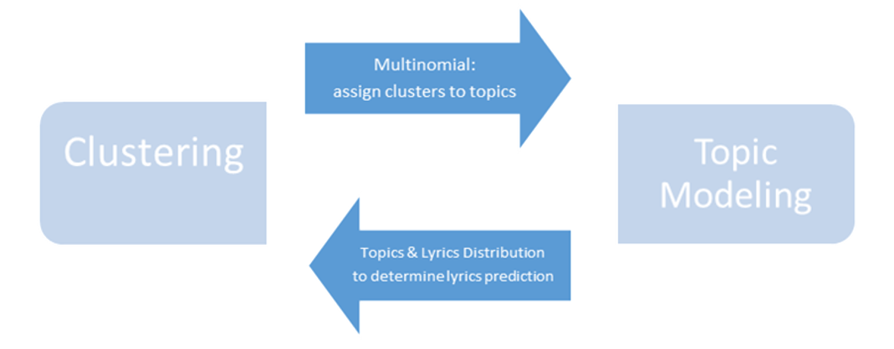
Concerns & Considerations
Feature Selection
PCA？
(1) principal component are used as new features, instead of the original variables
(2) only linear relationships are considered
175 features. Overfitting?
Clustering
Not well separated
Even if, similar bars = similar lyrics?
Topic Modeling

Slide 12
Thank you!

